Slide 1
VISUAL PASS
BY:-
NAME | REGISYTRATION NO.
UTKARSH GUPTA | RA2211003030116
ARCHIT JAIN | RA2211003030138
MEGHA GUPTA | RA2211003030302

Slide 2

AGENDA
This project mainly focuses on enhancing the security of the user’s data by providing them with the additional attribute of using images as a part of security question.

Slide 3
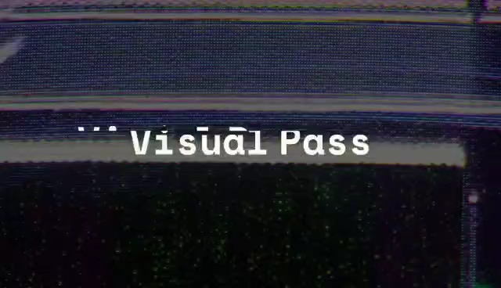
INTRODUCTION
The visual pass is an user interface , providing us with a salient feature which is the aggregation of human verification and captcha.It has been developed to enhance the security of the sensitive information of the user and prevent their data from leakage to the third party.

Slide 4
working
Visual Pass is an interface used by users for login and sign up activities in which the image selected by the user at the time of sign up plays a significant role during the time of login.The user has to select the correct image along with accurate password and e-mail for successful login.

Slide 5
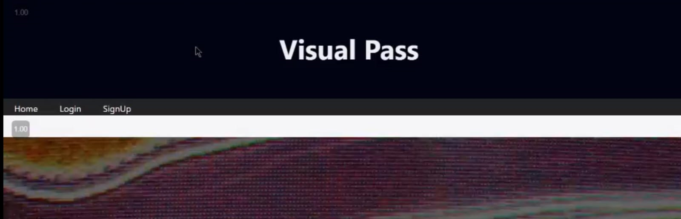
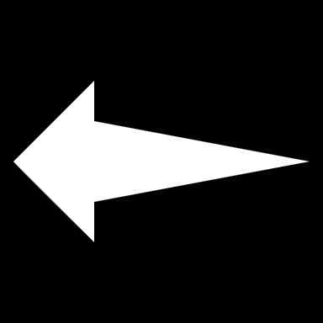


Here ,we are taking an example to show how the visual pass is going to work.
For instance,this will be our homepage for visual pass.
This is our homepage
This will be used for signing up
This is used for login

Slide 6
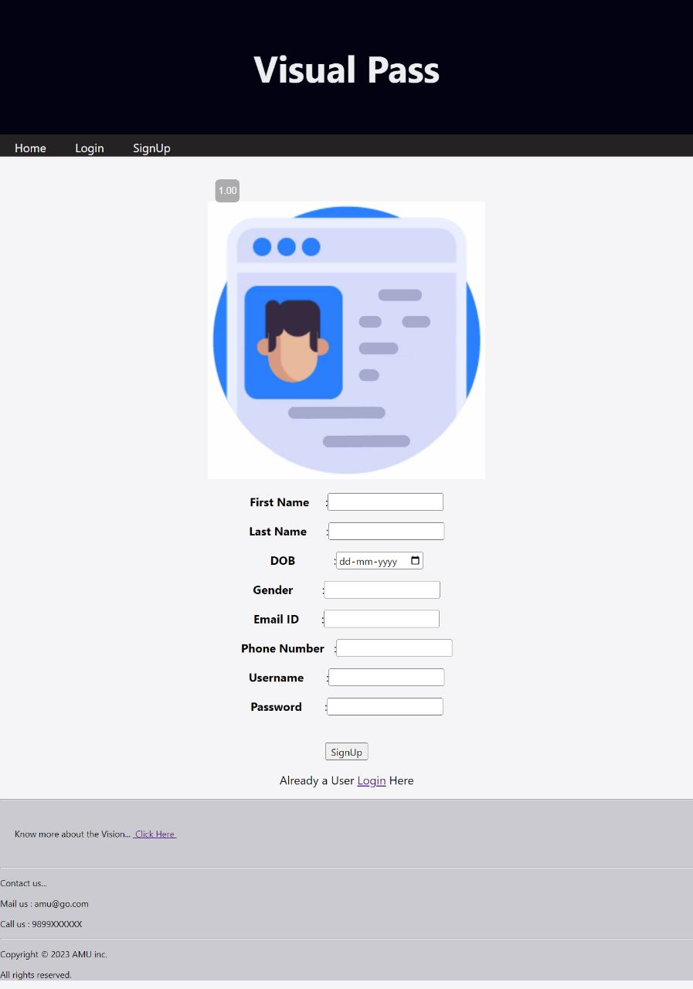
SIGN UP has following tabs:-
In sign up,we need to insert various credentials such as first name,e-mail,phone number,username and our password.

Slide 7
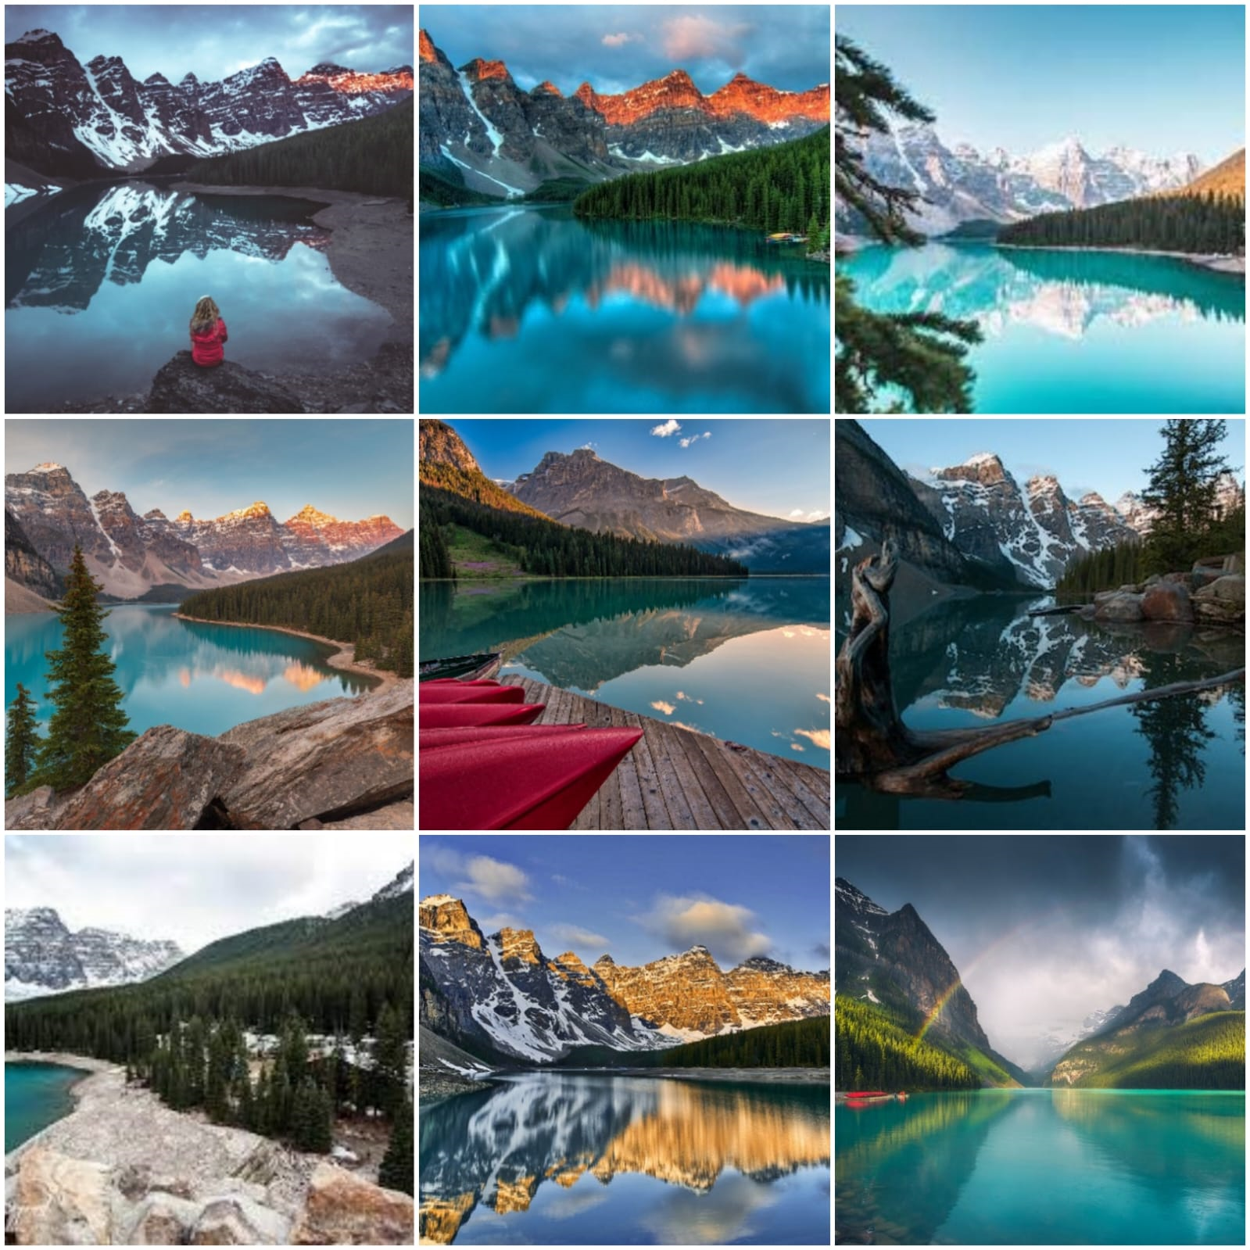
Consequently, the page will direct us to select the image as a security image which will be needed during the time of login.
We need to select any 1 image out of these 9 images

Slide 8
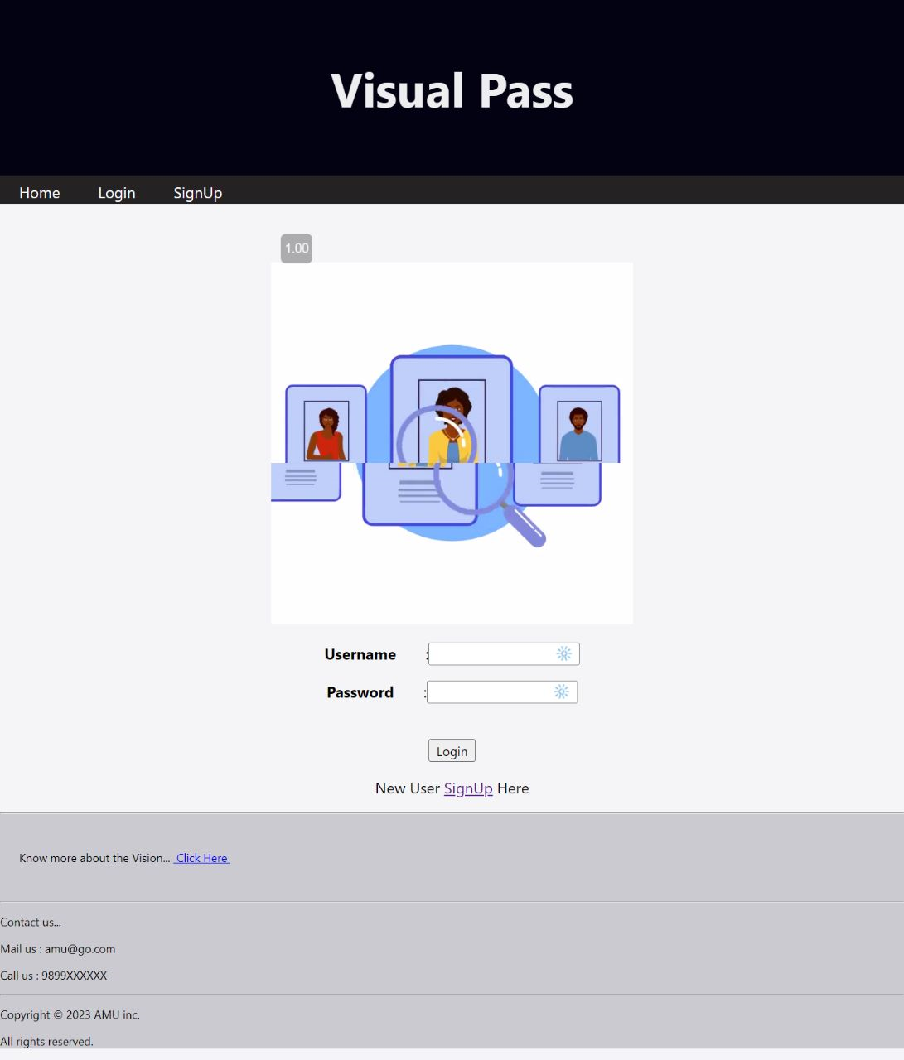
Now,we will be directed to the login page
It will be like a two step verification as we need to enter our password and correct image

Slide 9
Consequently, the page will direct us to select the image as a security image which will be needed during the time of login.
We need to select any 1 image out of these 9 images

Slide 10
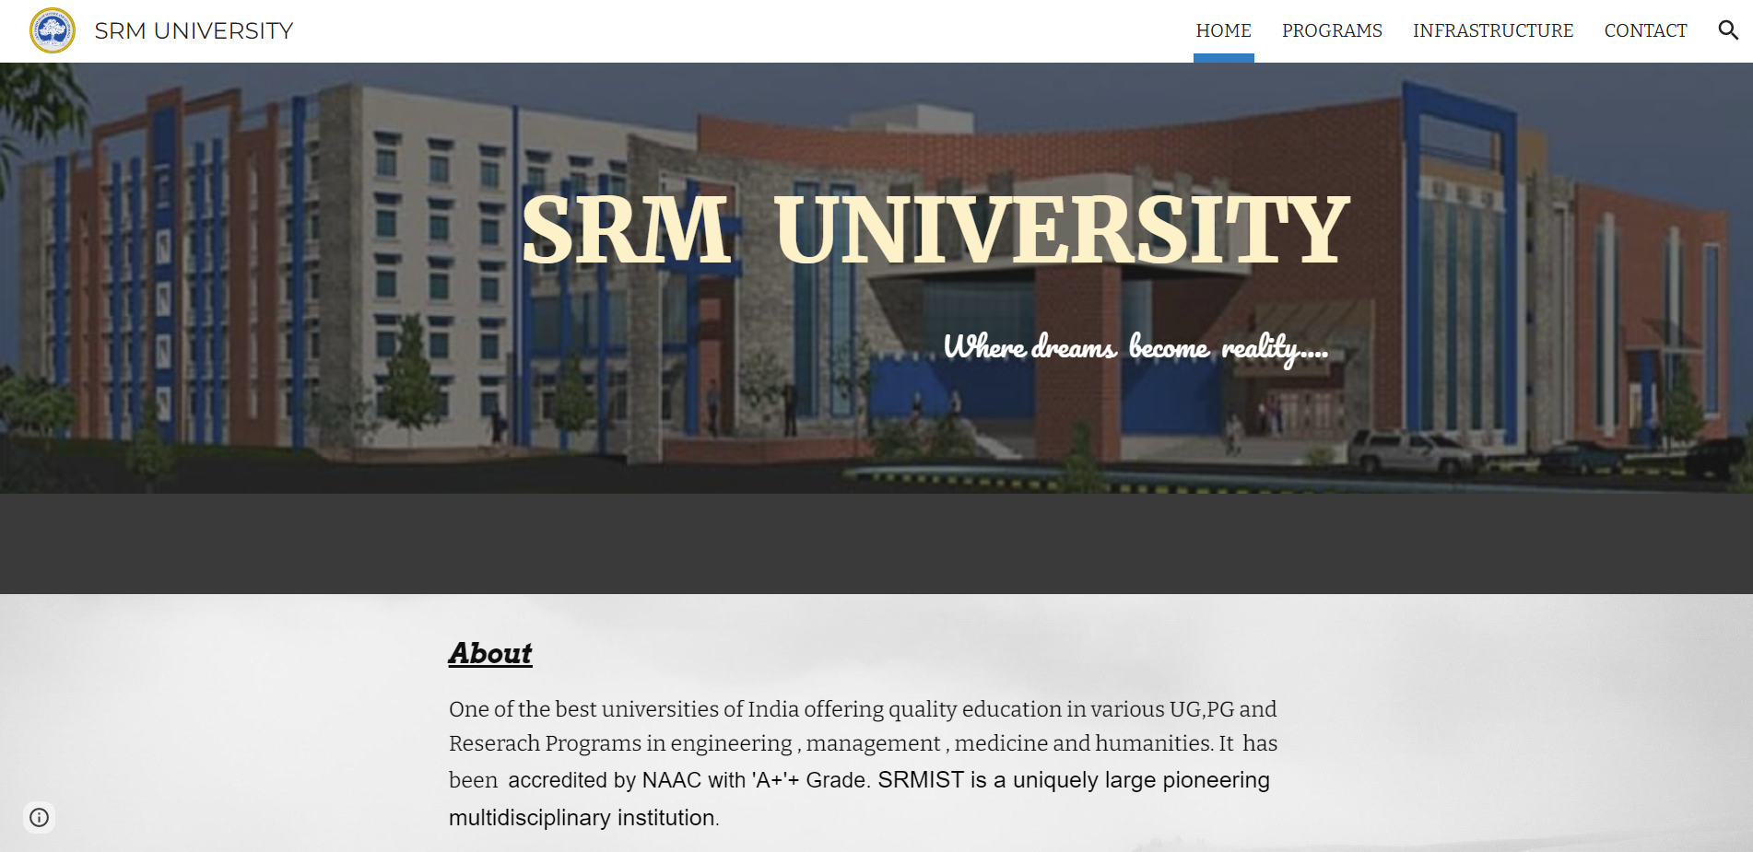
After login,we will be directed to the landing page which for instance will be a website of a university.

Slide 11
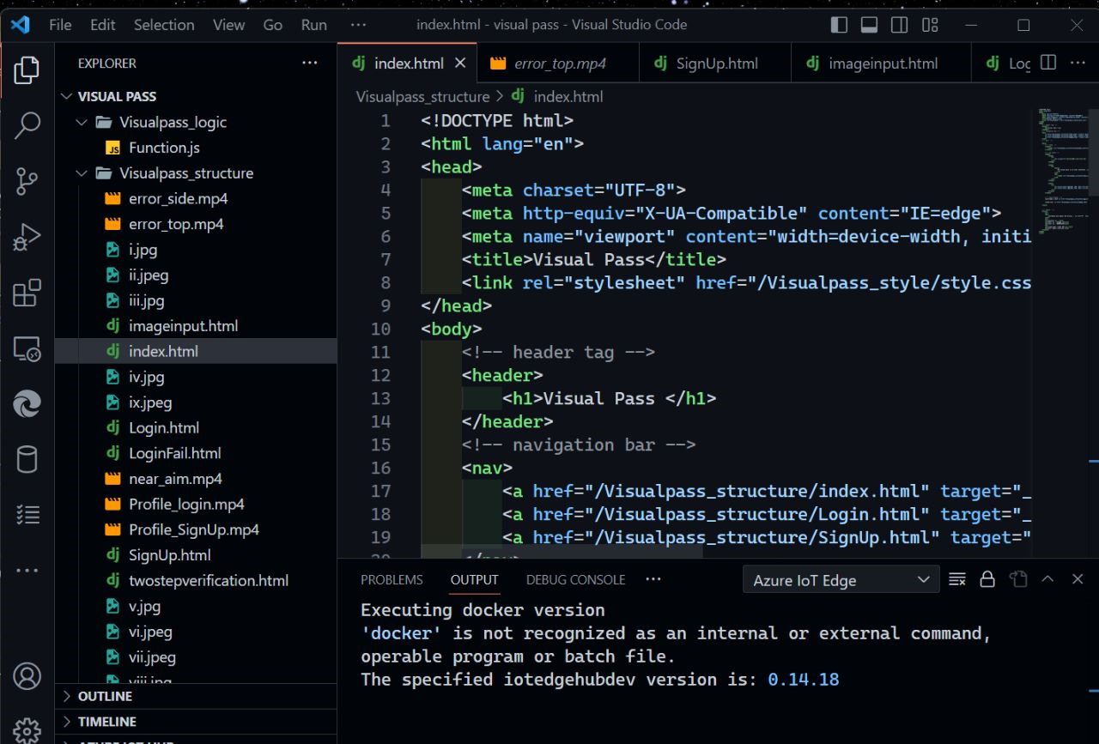
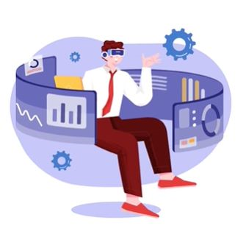
SOME VISUALS OF FRONTEND DEVELOPMENT

Slide 12
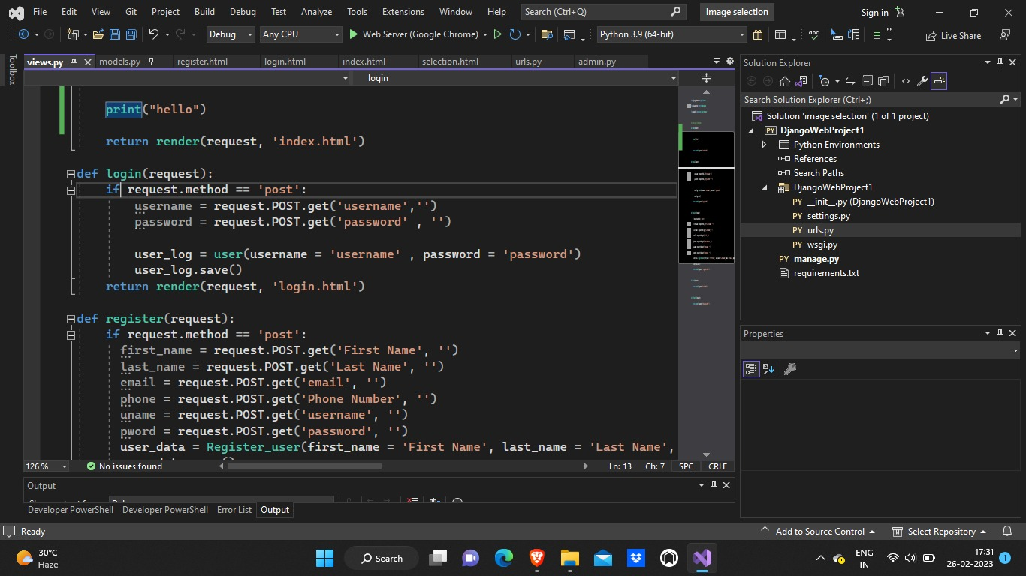
Some visuals of backend development

Slide 13
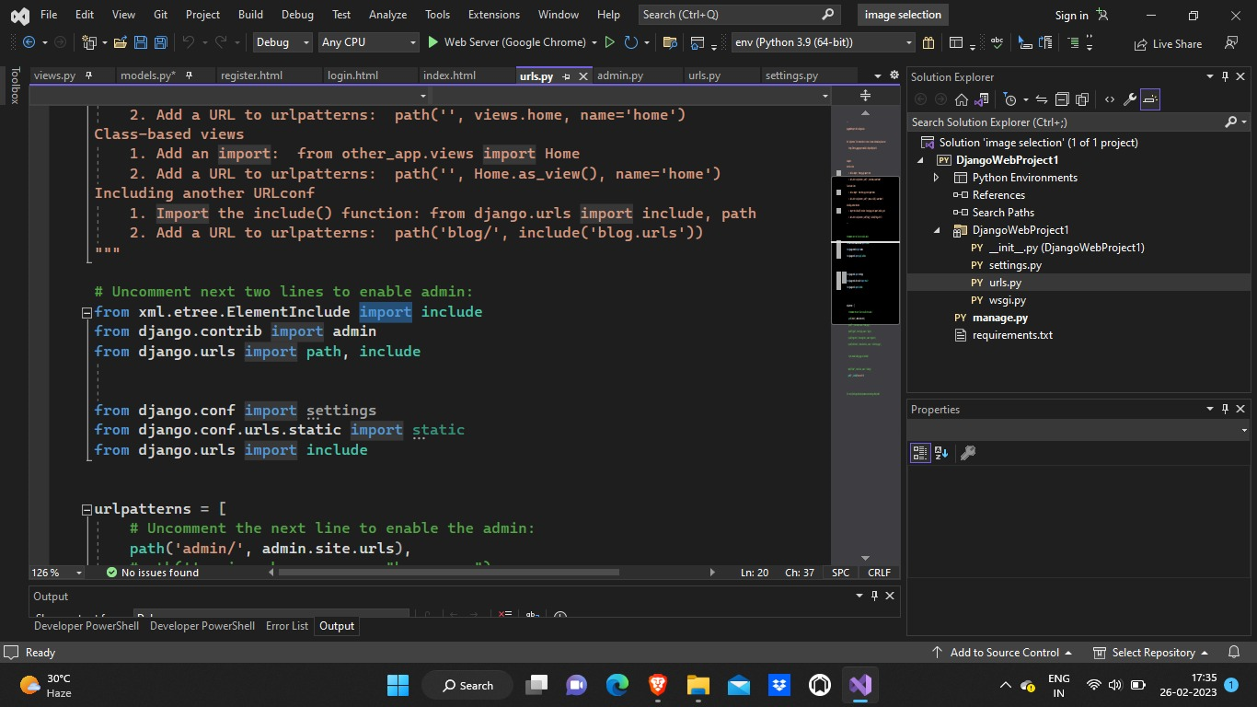
Our team has use different languages like HTML,CSS and Django for this project.

Slide 14
THANK YOU

